Slide 1
About Arabic
We at AAESS follow the ministry of education rules (ADEC).
All students, Arabs and non Arabs, must take Arabic as it is a compulsory subject.
Students are split up into 2 groups, Arabic 1 (for native Arabic speakers) and Arabic 2 (for non native Arabic speakers).
Arabic books are provided by the MOE and we follow them to create schemes of work, weekly plans and yearly plans.
We prepare the students to access the Arabic language through the language skills; reading, writing, speaking and listening.

Slide 2
Department Background
4Teachers across secondary.
Two teachers teach in both primary and secondary.
In KS3 and KS4 each year group is split into 4 groups (2 Arabic 1 and 2 for Arabic 2)
In Six form; each year group is split into two groups (Arabic 1 and Arabic 2)
The students who choose Arabic GCSE are expected to write an exam at the end of year 11.
The year 12 students must write and pass (with 60%) the MOE exam in order to get the equivalence for their certificate.

Slide 3
Assessment in the Arabic department
UPDATED RESOURCES FOR THE PRESENTSTION\Assessment Criteria_Cycle Arabic.docx

Slide 4
ADEC Report/ Feedback
ADEC REPORT
Meeting ADEC requirements
UPDATED RESOURCES FOR THE PRESENTSTION\Actions against ADEC feedback- Report.docx
Action Plan
Action Plan 2015
UPDATED RESOURCES FOR THE PRESENTSTION\ARABIC ACTION PLAN 2015.docx
Action Plan 2015- 2016
UPDATED RESOURCES FOR THE PRESENTSTION\UPDATED ARABIC ACTION PLAN 2015-2016.docx

Slide 5
ADEC's expectation
UPDATED RESOURCES FOR THE PRESENTSTION\اللقاء التعريفي.pptx
UPDATED RESOURCES FOR THE PRESENTSTION\ADEC's expectation.docx

Slide 6
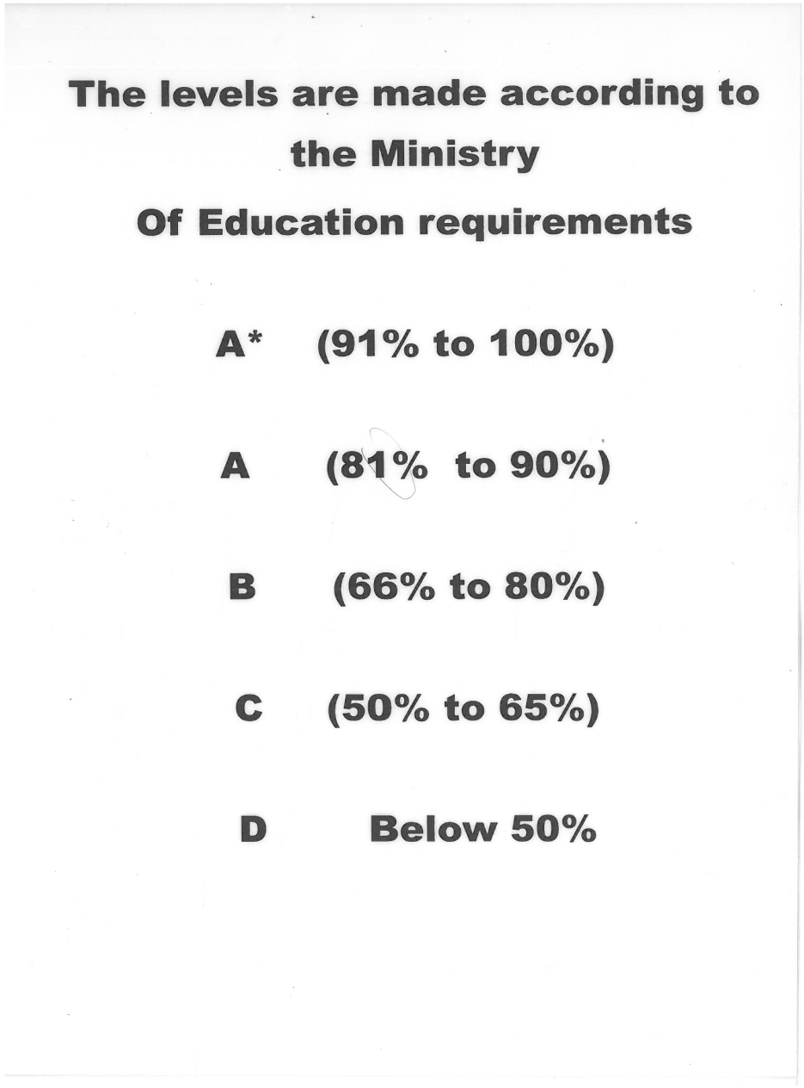
Arabic levels according to ADEC’s recommendation – high expectation
% Range | symbol
50 -54 | D
55 -60 | C-
61 -64 | C
65 -69 | C+
70 -74 | B-
75- 79 | B
80 -84 | B+
85 -89 | A-
90- 94 | A
95 -97 | A+
97 + | A*

Slide 7
Level Description
UPDATED RESOURCES FOR THE PRESENTSTION\Level description Standard - Arabic 1.docx

Slide 8
Grade Tracking
grade tracking spreadsheet
Students are split up into sections of different levels depending on the placement test at the beginning of every academic year.
Teachers in the Arabic department are required to test their students through weekly quizzes, mid term, end of term tests in addition to the end of every term.
At the end of the year, an average mark for each student is sent to the MOE and the passing mark is 50% for primary and 60% for secondary.
New and year 7 students Write a placement test at the beginning of year.

Slide 9
Grade tracking/Term (ADEC)
اختبار تحريري 40 |  |  |  | أنشطة صفية 30 |  |  |  | أنشطة لا صفية | المجموع النهائي
منتصف الفصل |  | نهاية الفصل |  | كتابية (تعبير + إملاء) |  | قرائية ( استماع وتحدث) |  | المشروع/ تكليفات
20 |  | 20 |  | 20 |  | 10 |  | 30 | 100 | تقدير العلامة
اسم الطالب |  |  |  | التعبير | الإملاء | منتصف الفصل | نهاية الفصل

Slide 10
Grade tracking/Year (ADEC)
اسم الطالب | امتحان تحديد المستوى | تقدير العلامة | امتحان الفصل الأول | تقدير العلامة | امتحان الفصل الثاني | تقدير العلامة | امتحان الفصل الثالث | تقدير العلامة | الدرجة النهائية مع التقدير

Slide 11
Expectations, achievements and interventions based on the September, 2015 placement test
Year group | Expected level
7 | D to C- (50-60%)
8 | C to B- (61-74%)
9 | B- to B+ (70-84%)
10 | B- to A (70-94%)
11 | B- to A (70-94%)
12 | B to A (75-94%)
Year group | Below expected level | At expected level | Above expectation
7
8
9
10
11
12

Slide 12
Intervention (Personalised Plan) for the
Lower Achieving Learners
Sept
Term 1
Oct

Slide 13
Personalised Plan /
Higher achieving learners
الفترة الدراسية Term 1 |  | نواحي ومظاهر التفوق Standards description (higher achieving students) | أسباب التفوق و التميز Reasons for high achievement | خطة الإثراء و المتابعة Development and progress plan | مؤشر النجاح Success criteria
الفصل الأول Term 1 |  | ( ) المشاركة الصفية و إنجاز الأعمال بسرعة ( ) ارتفاع المستوى التحصيلي و الرصيد اللغوي ( ) الاهتمام بالواجبات المنزلية ( ) القدرة على القراءة والكتابة بمهارة ( ) القدرة على الحفظ ( ) الاتزان و قوة الشخصية ( ) الإبداع في الشعر و كتابة القصة ( ) وجود السمات القيادية | ( ) ارتفاع مستوى الذكاء ( ) متابعة الأسرة ( ) تنظيم الوقت ( ) الإحساس بالمسؤولية ( ) قوة الدافعية لدى الطالبة ( ) الثقة بالنفس ( ) تنويع المطالعات | ( ) تولية الطالبة مهام قيادية ( ) المشاركة في خطط الدروس و العروض التقديمية ( ) التنويع في أوراق العمل الاثرائية ( ) إشراك الطالبة في نشاطات المدرسة ( ) إشتراك الطالبة في المسابقات و الجوائز ( ) المكافآت المادية و المعنوية ( ) إبراز أعمال الطالبة في بوردات المدرسة
Sept

Slide 14
Data Analysis 2015

Slide 15
Achievements
All the Arabic teachers who teach Arabic at the school are qualified and ADEC approved.
Arabic GCSE past paper booklets
Got Mohammad Al Hashemi’s approval for using the GCSE Arabic 2 books.
uploading primary Arabic weekly plans on the school website
AAESS is the only school in Al Ain that covers the Arabic as a second language GCSE curriculum.
Arabic GCSE (Year11) and MOE (Year12) exam results
The students’ results in both exams are excellent

Slide 16
Achievement – EMSA
External Measure of Student Achievement
EMSA is usually run in the government school. Last year our school was chosen along with 60 private schools in Al Ain to administrate the EMSA exam. The test is marked by external teachers and inspectors.
Years 5, 7, 9 and 11 (first language Arabic speakers) students wrote the EMSA exam per ADEC guidance. The exam consists of two papers; Reading and Writing. The students write both papers in the same day but in two different sessions with 30 minutes break.

Slide 17
Achievement – Competitions/ Contributions
Arabic/ Environmental - Writing and Oral competitions
Participated in Arabic competition organised by ADEC across Al Ain where our students compete with their peers from the other private schools and won the first prize.
National Day celebration
The organization of the National Day celebration for UAE while the presence of guests from ADEC.

Slide 18
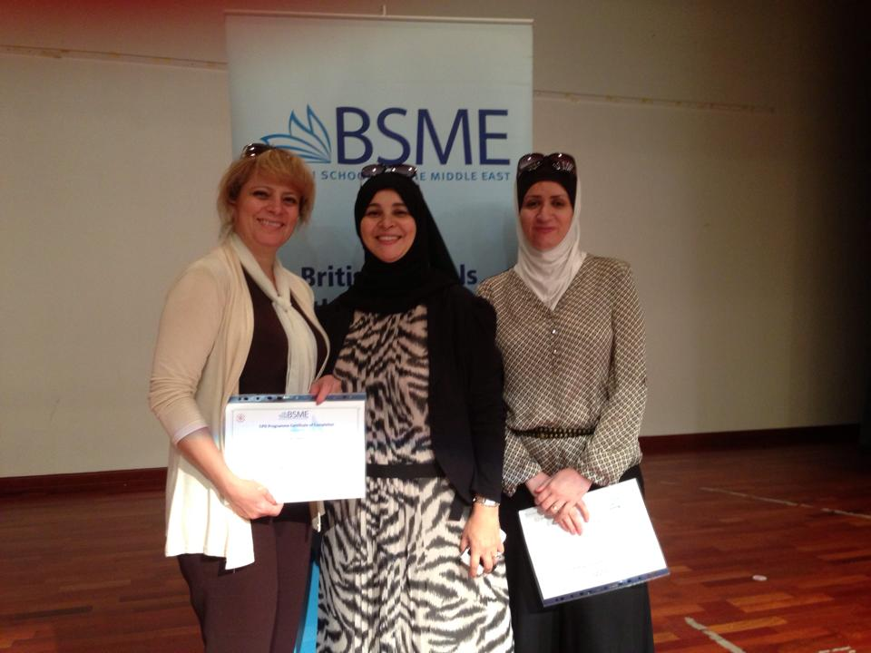
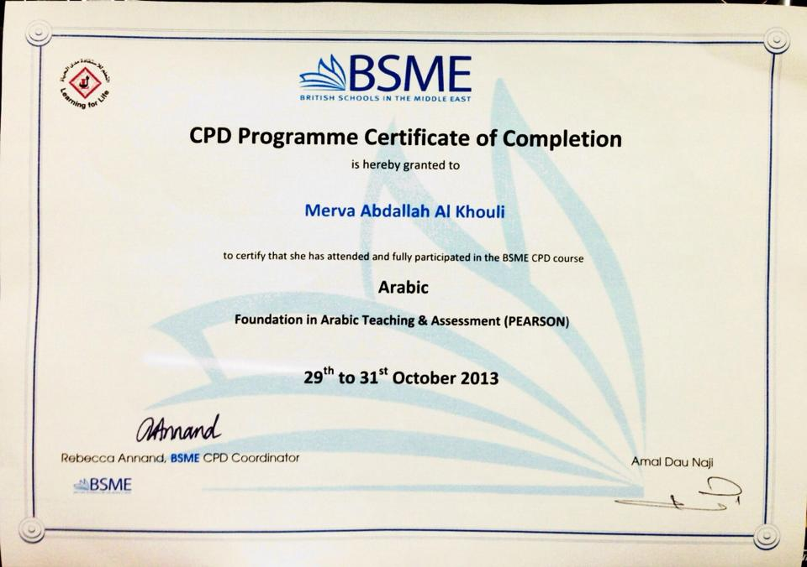
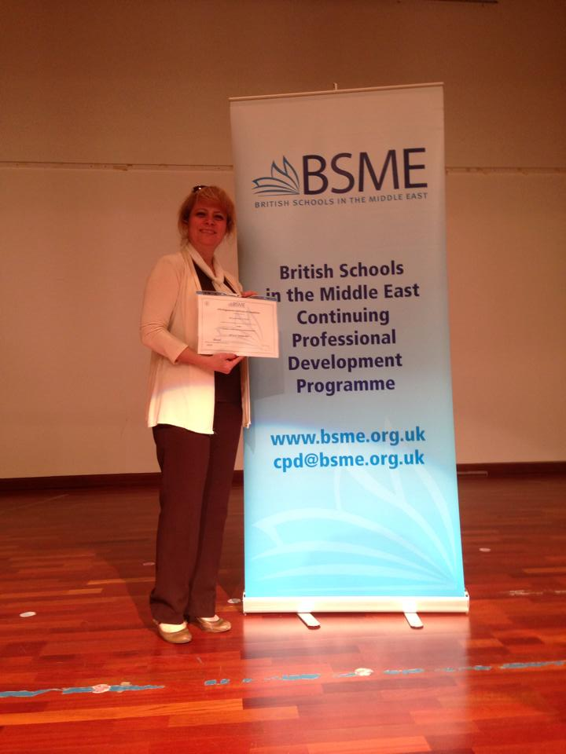
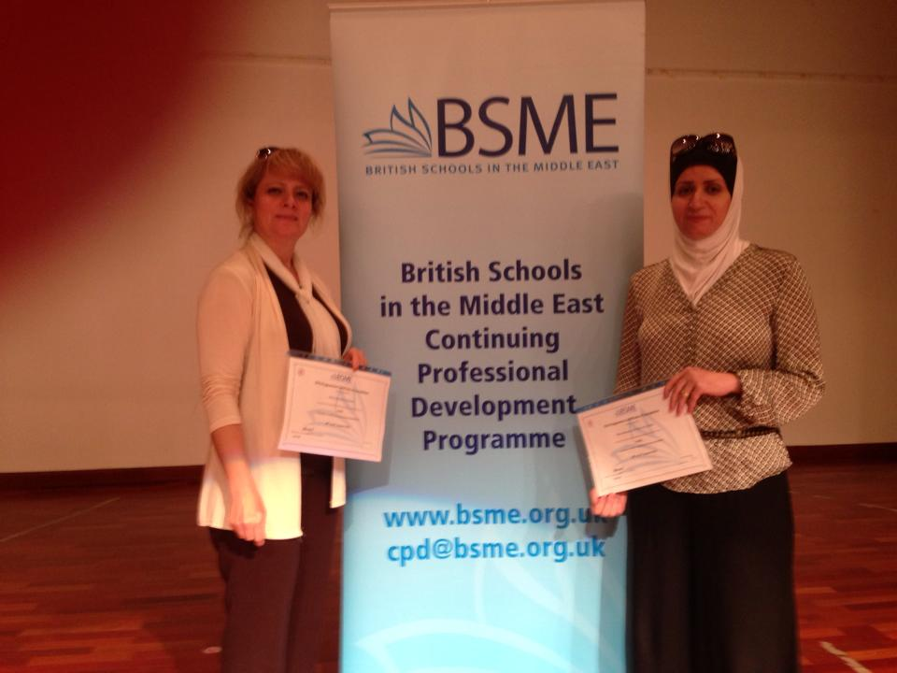
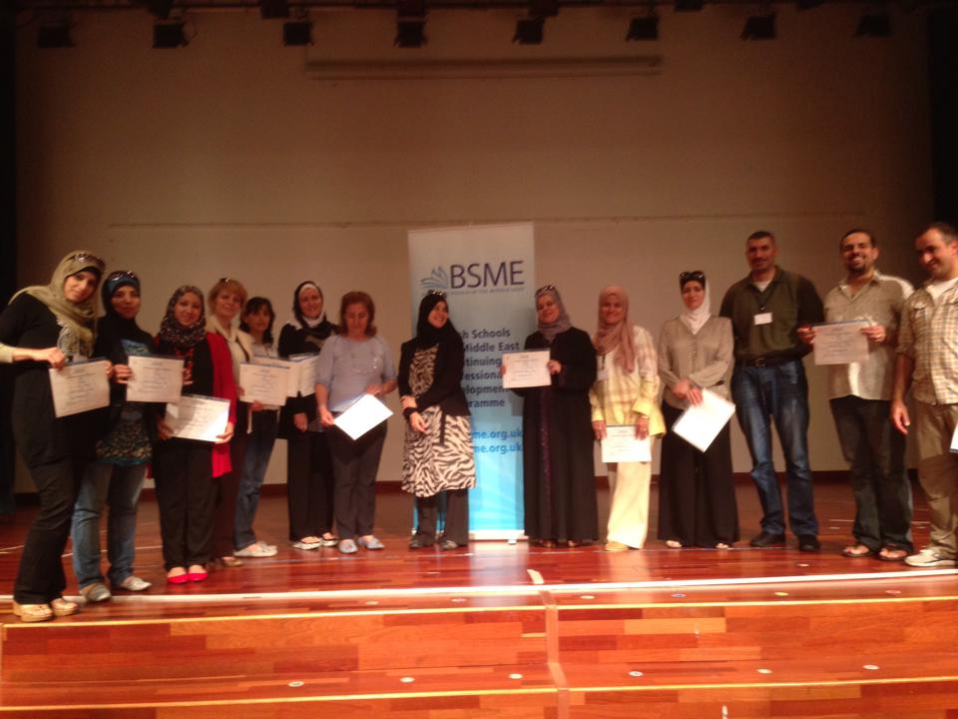
Achievements
Attending the BSME course in Dubai and adapting the different teaching methods.

Slide 19
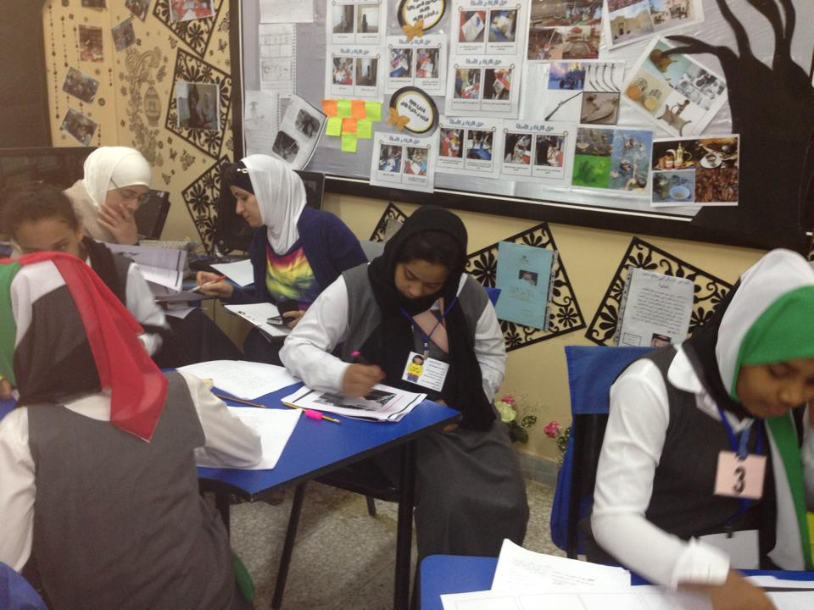
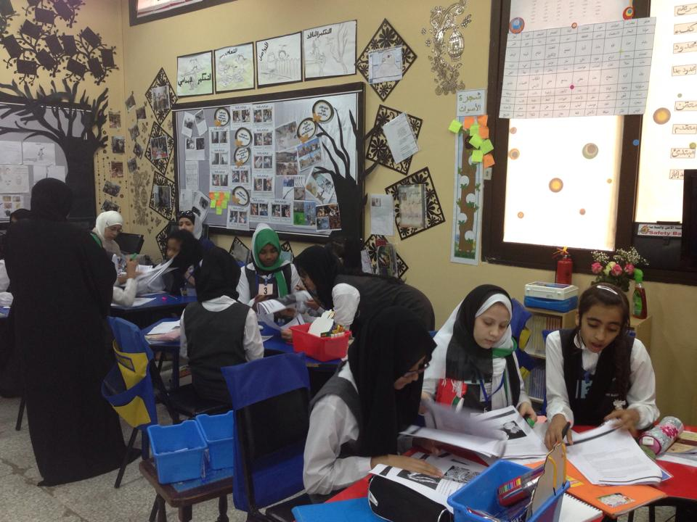
Achievements
Observing various lessons at Atiqa School.

Slide 20
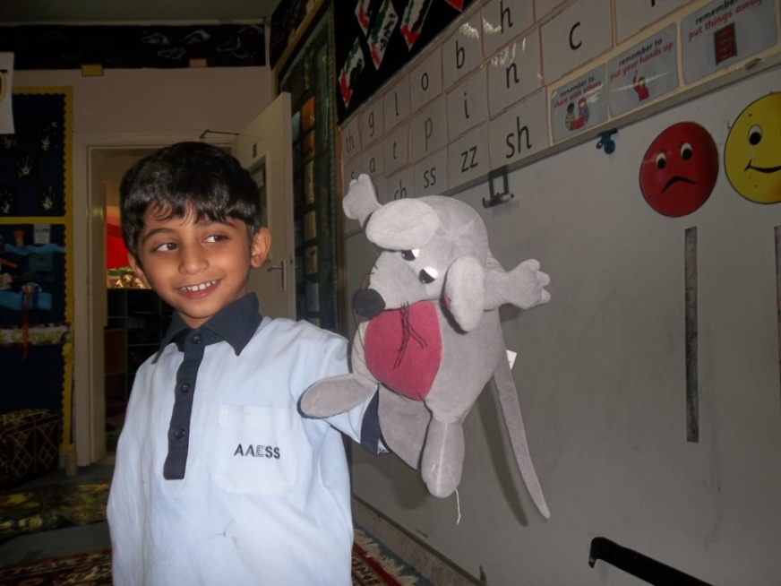
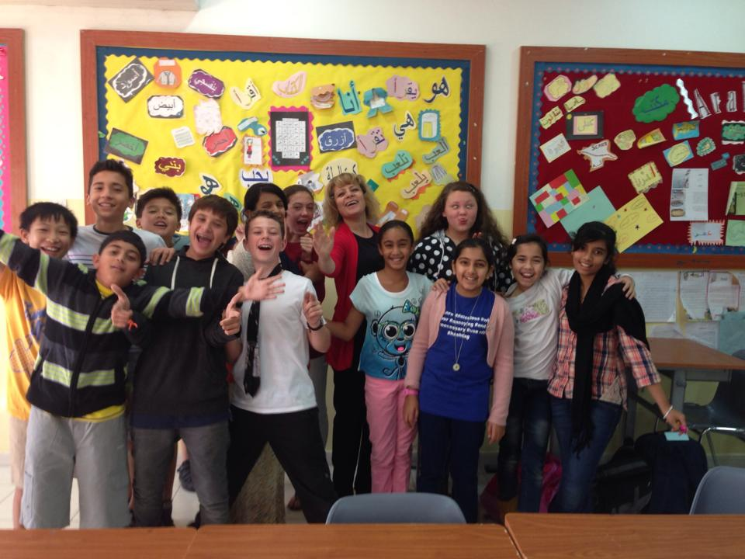
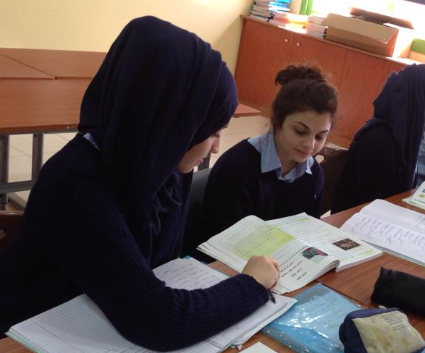
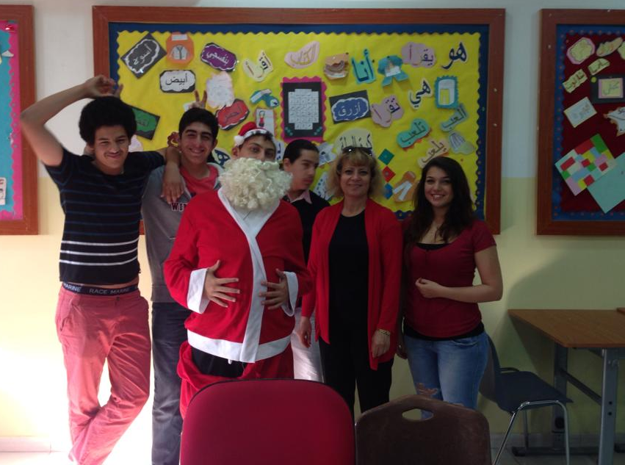
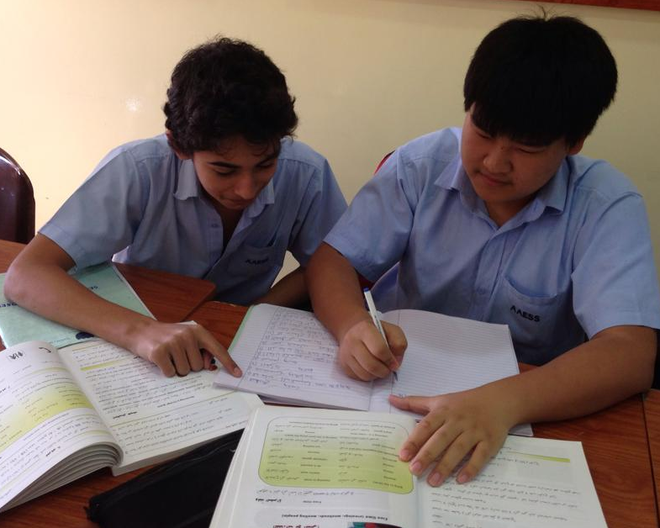
Achievements
Encouraging students to have confidence when speaking in Arabic.
Throughout the courses and observing lessons, we adapted the following teaching methods.
Building good relationships with the students.
Encouraging Team work and cooperation.

Slide 21
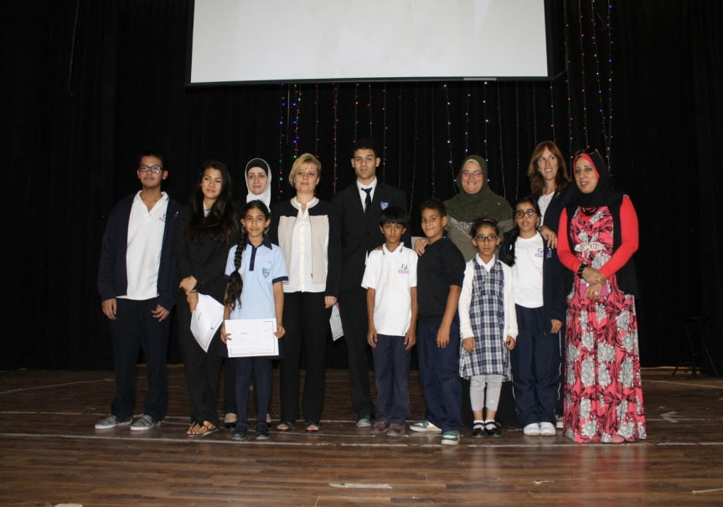
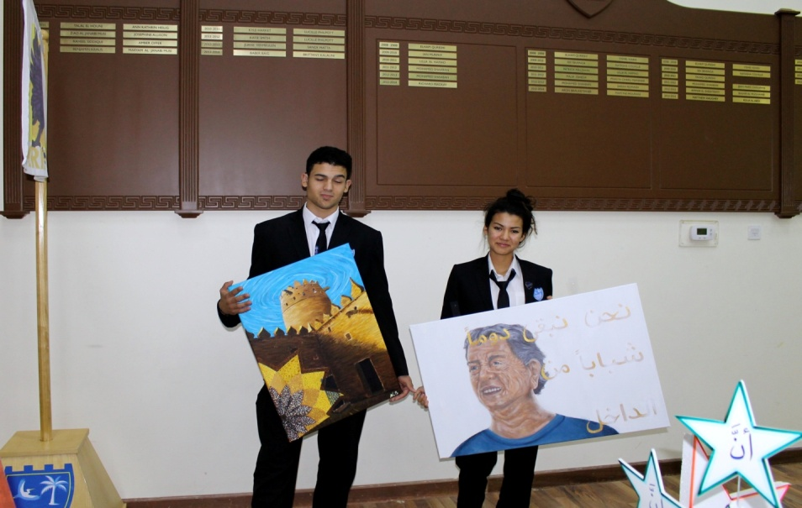
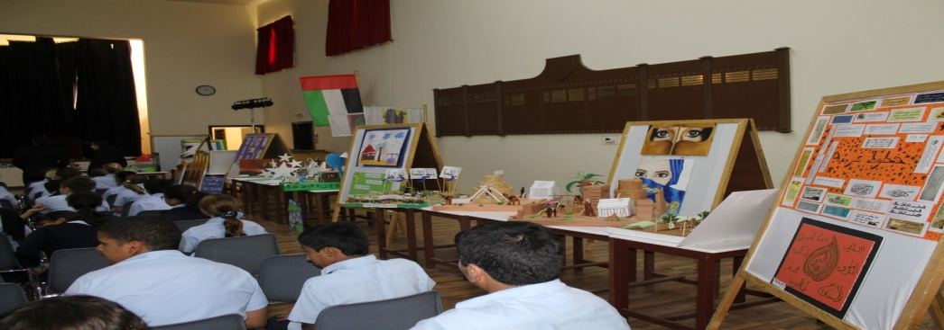
Achievements
Arabic Competition and Arabic Week
Motivate the students to take part in the Arabic Annual Exhibition in order to rise with the love of the Arabic Language.

Slide 22
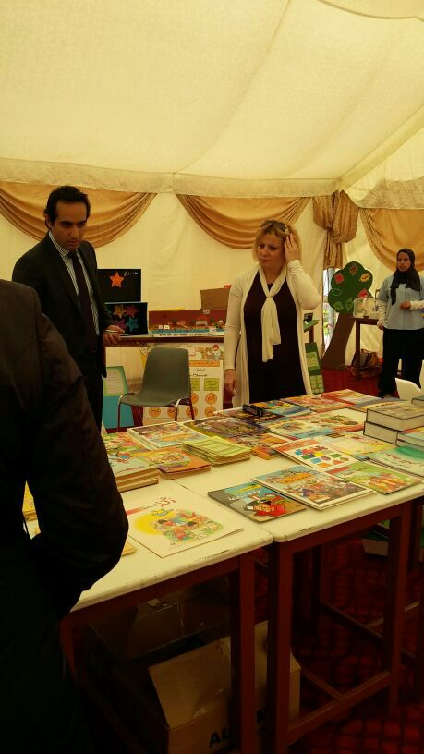
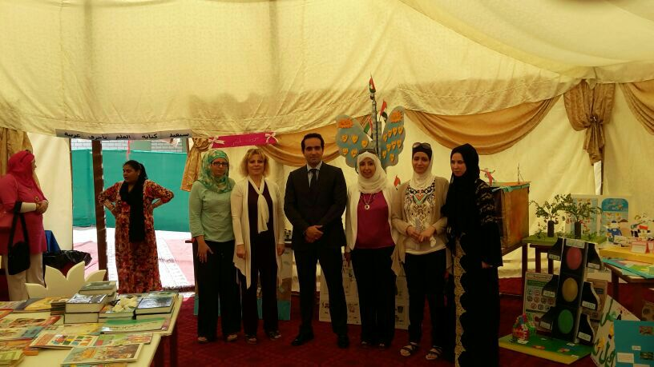
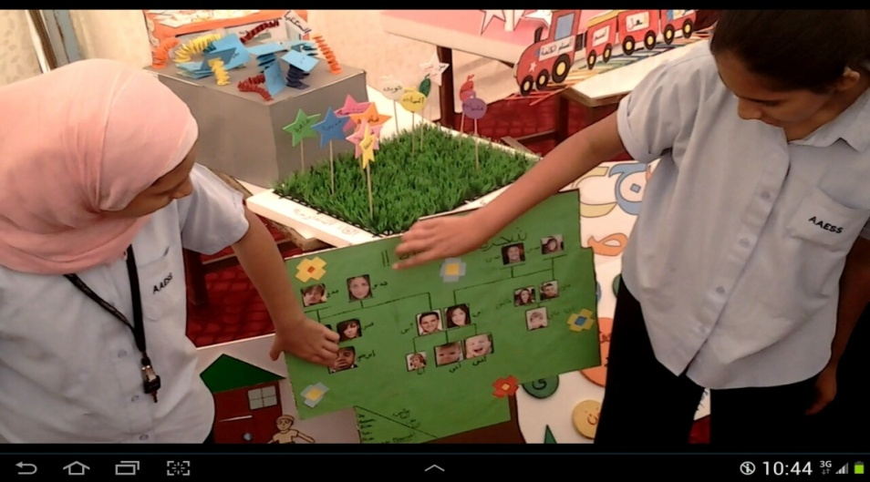
Arabic exhibition
UPDATED RESOURCES FOR THE PRESENTSTION\نموذج تقرير أسبوع اللغة العربية في المدارس الخاصة (1).docx

Slide 23
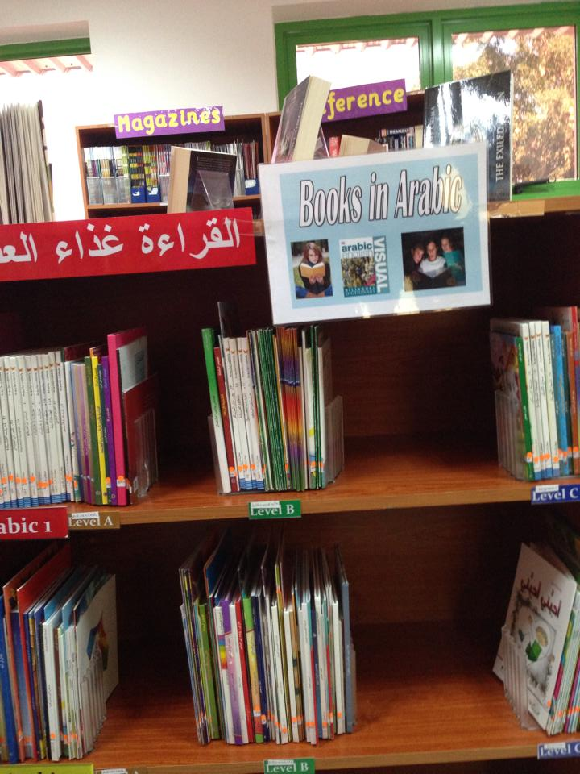
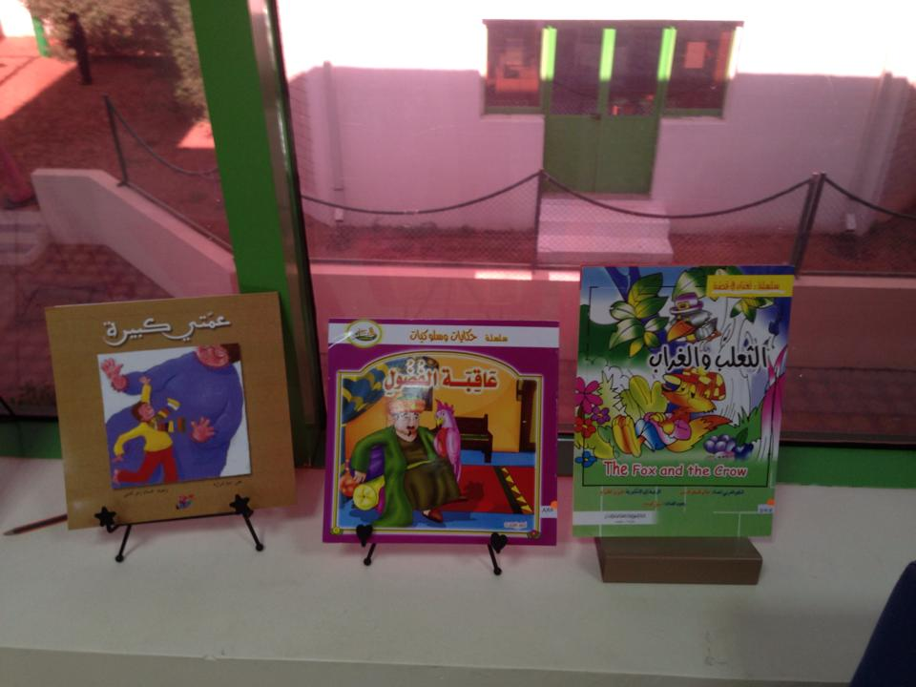
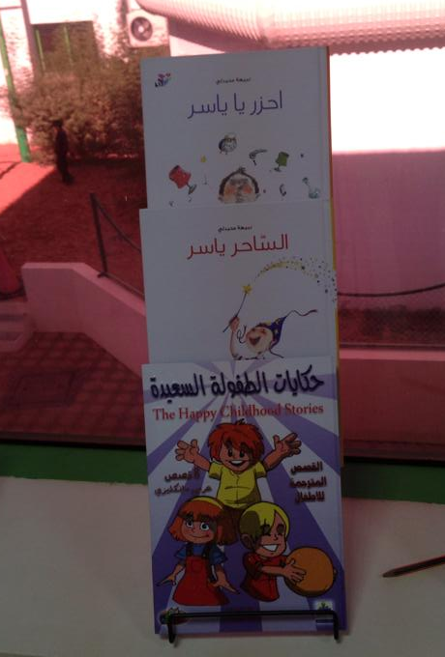
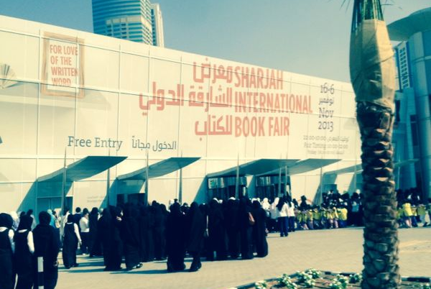
Achievements
Providing Arabic books and stories in both the primary and secondary libraries and organising reading lessons to encourage students to read in Arabic.

Slide 24
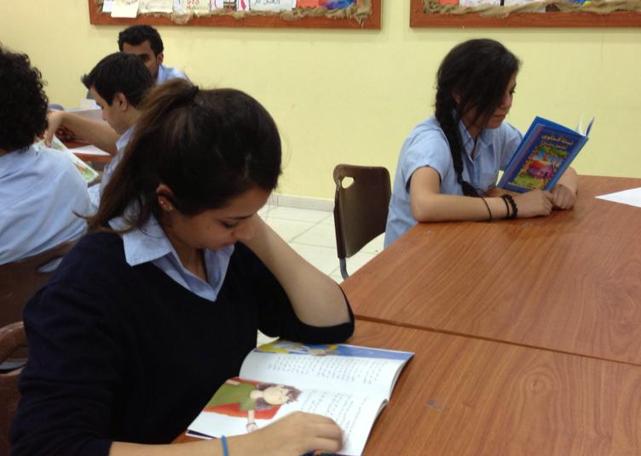
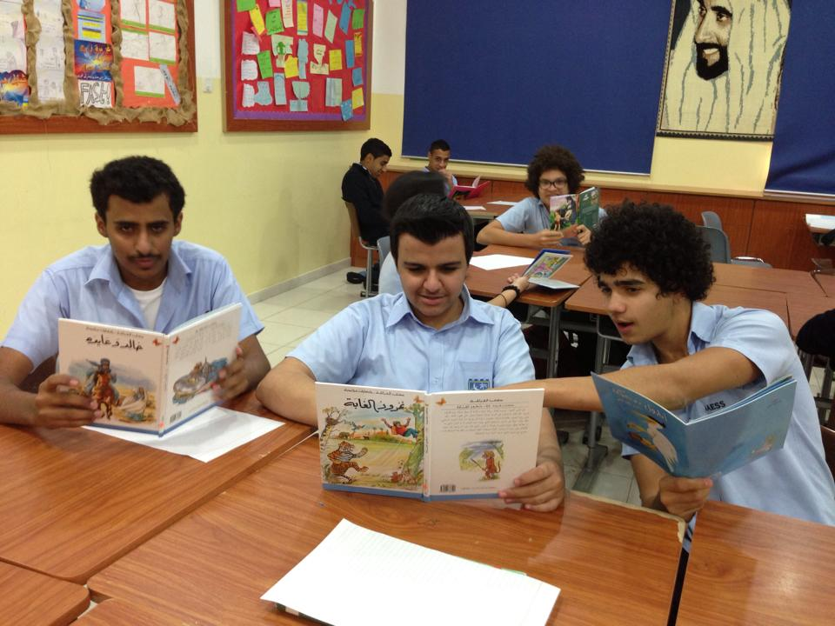
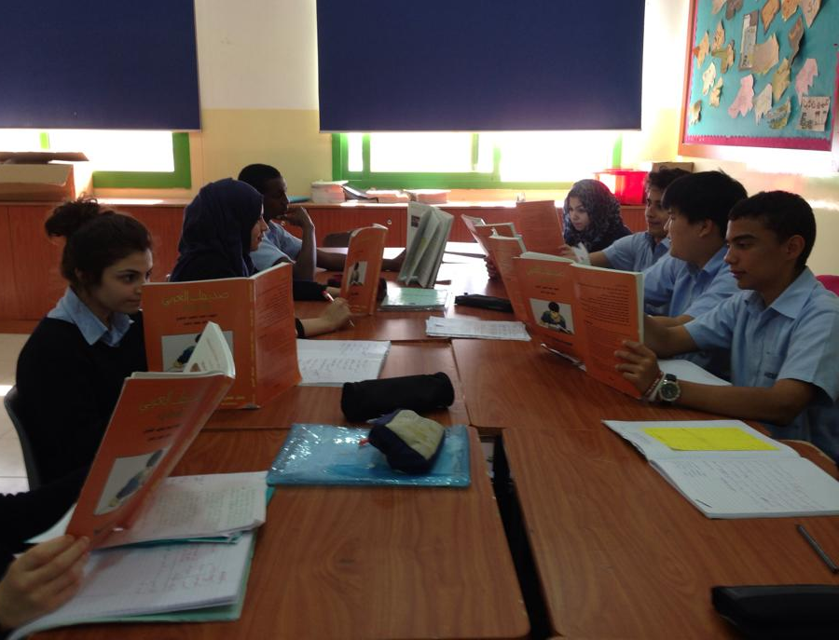
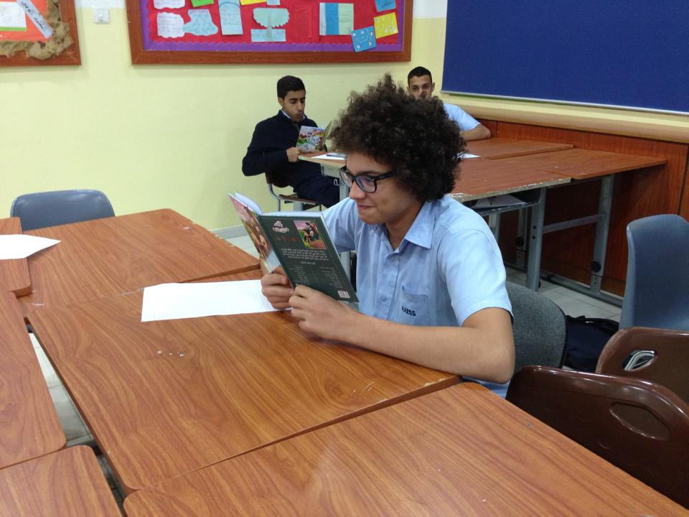
Achievements
Reading lessons:
Students are encouraged to read in Arabic in class.

Slide 25
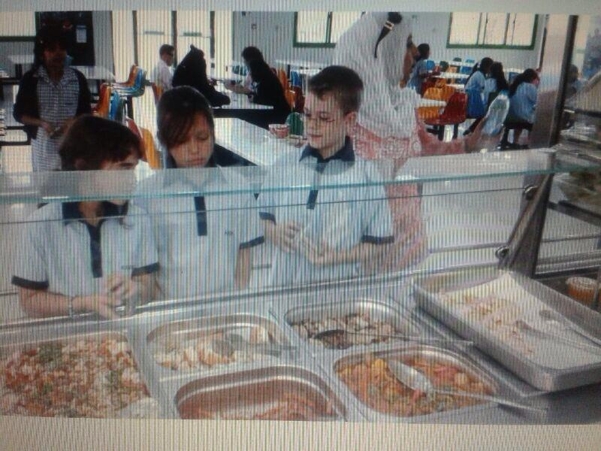
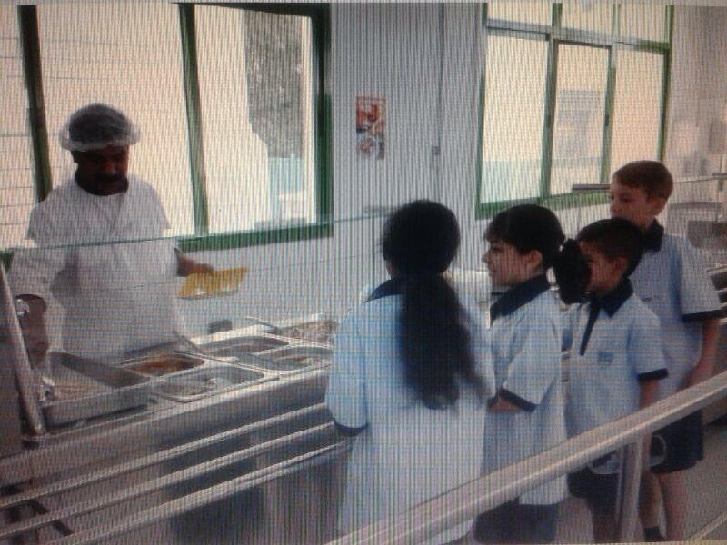
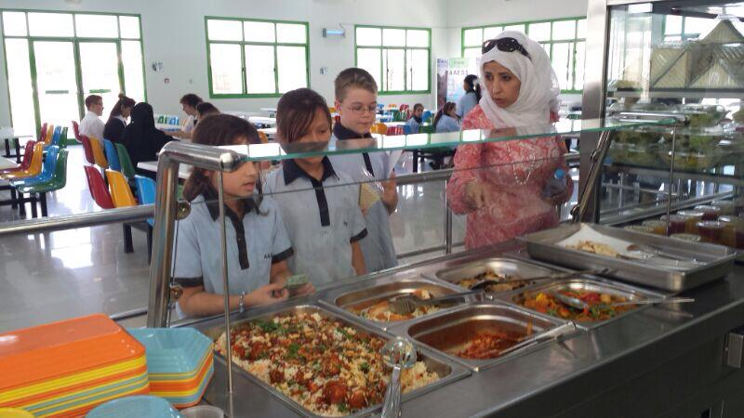
Achievements
Taking the non Arab students to the cafeteria to practise ordering food and drinks in Arabic.

